Slide 1

diabetes risk prediction
X23176725 Bolormaa Mendbayar
X23187294 Temitope Oladimeji
X23131535 Thapelo Khantsi

Slide 2
Outline
Intro:
Chosen Topic
Chosen Methodology
Model Justification
Findings and Interpretation:
Correlation Matrix
Business Value:
Business value based on findings
ANN model evaluation results and interpretation

Slide 3
Predictive Analytics in Healthcare
Quickly identify at-risk patients. Quicker interventions.
Predict the likelihood of health conditions.
Predict patient outcomes.
Reduce cost etc.

Slide 4
Why ANN?
Tolerance to faulty inputs.
Parallel processing.
Can also model non-linear/complex relationships etc.
High proven accuracy in disease detection.

Slide 5
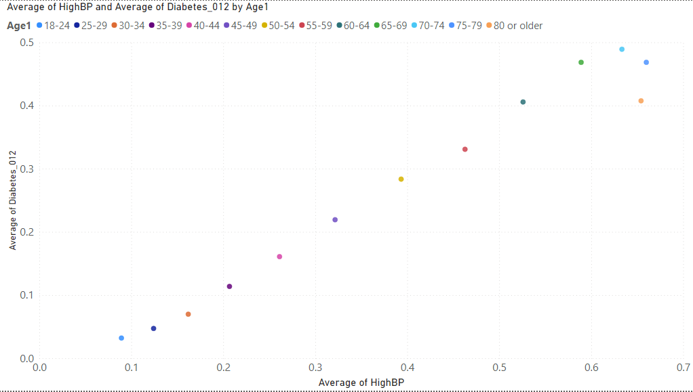
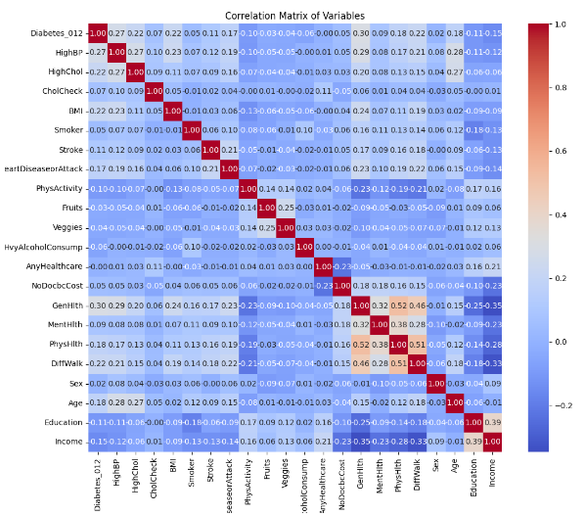
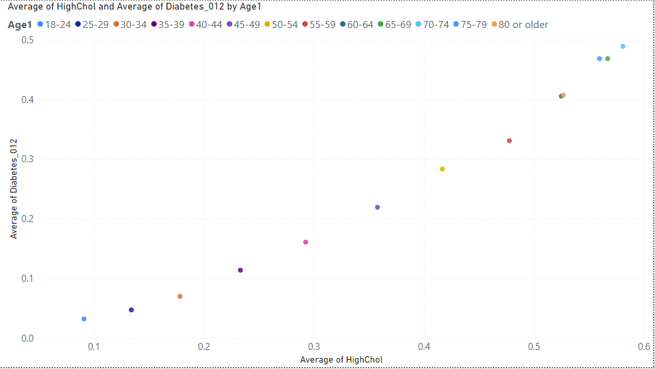
Findings
Risk of Diabetes
Age ~ BP and Chol ~ Risk of Diabetes
Risk of Diabetes
Highly correlated variables
HighBP, BMI, HighChol, GenHlth
General - Education, Income

Slide 6
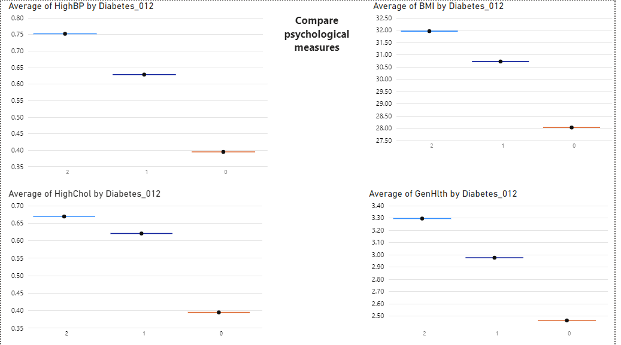
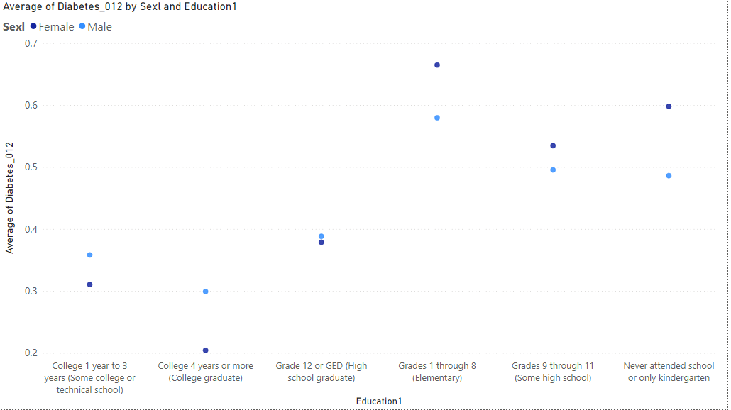
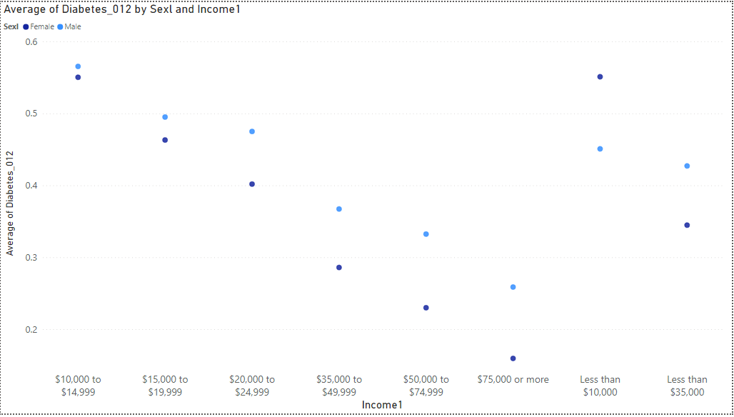
Quantitative Findings
0 – no diabetes
1 – prediabetes
2 - diabetes
Obesity
Risk of Diabetes
Only attended Kindergarten, Elementary, and High school has high risk
Physiological measures for high risk
BP≥ 0.63
BMI ≥ 30.75
Chol ≥ 0.625
GenHlth ≥ 2.95
Risk of Diabetes
Less than $15’000 has high risk

Slide 7
Findings from ANN
For possible improvement Feature Selection and Engineering, hyperparameter tuning is recommended.
Sensitivity | Specificity
0.88 | 0.86

Slide 8

Business Value of ANN
Improved Health Outcomes
High-performance computing for analysis on large datasets of individual medical records.
Early diagnosis for early interventions to prevent progression
Healthcare Costs Reduction
Diagnosis Efficiency
Freeing up doctors' time to only focus on patient care.
High risk identification of patients for allocating resources more efficiently.
Proactive and Data Driven Decisions
ANN shifts the focus from reactive treatment to proactive prevention
Vast amounts of data analyzed by the model for informed healthcare decision

Slide 9


